Slide 1


Burlington Junior School

Slide 2
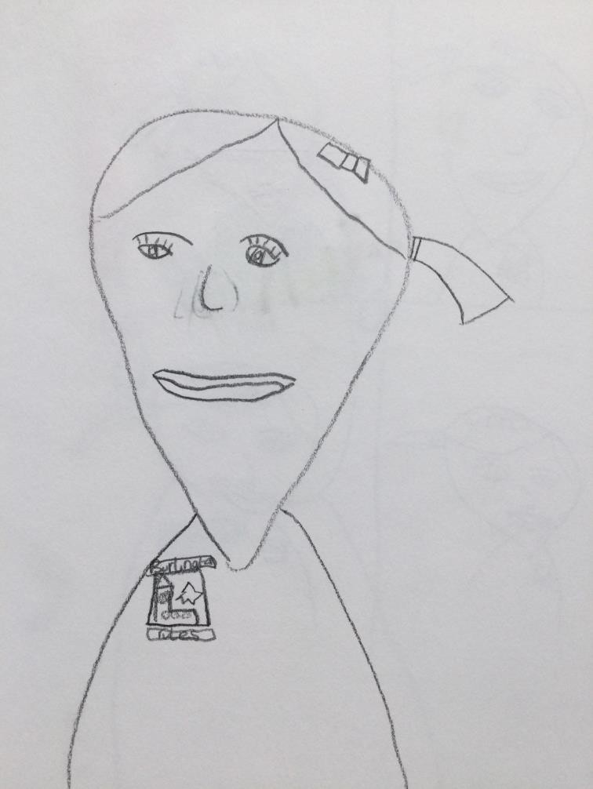

YEAR 3

Slide 3
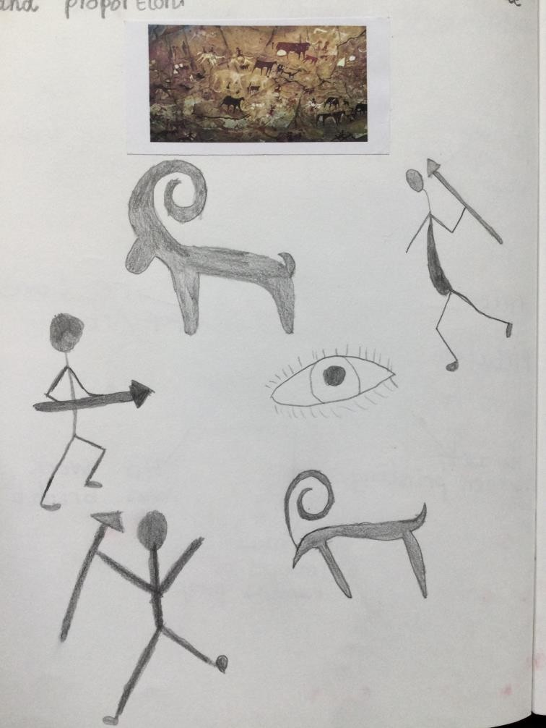
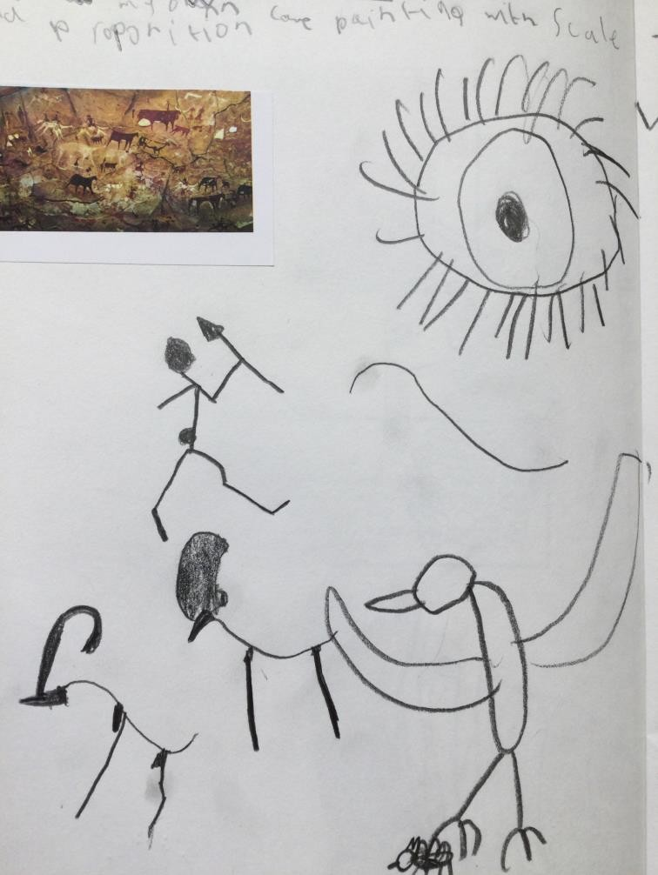

Slide 4
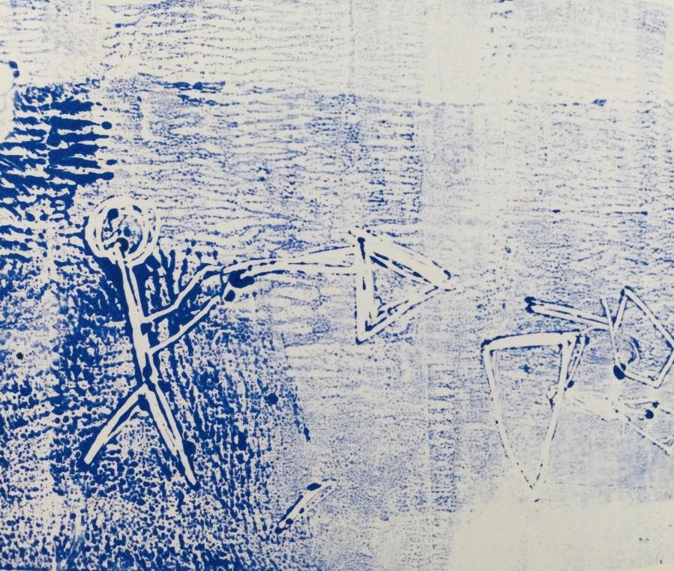
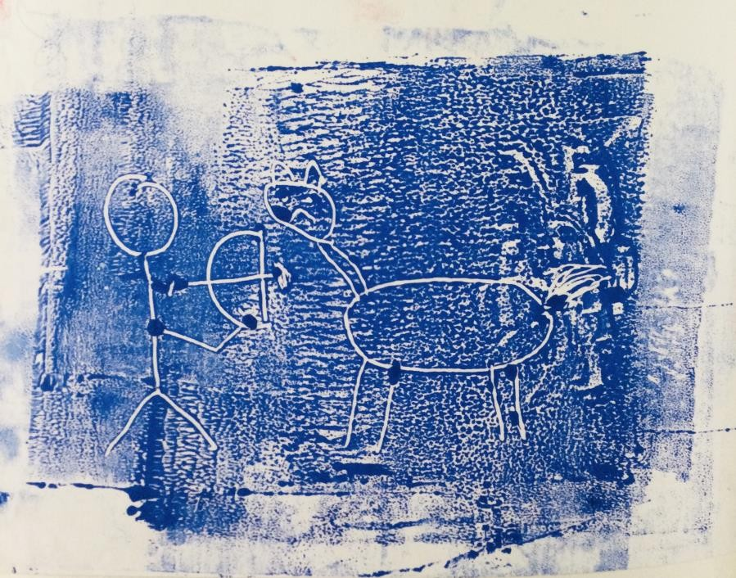

Slide 5
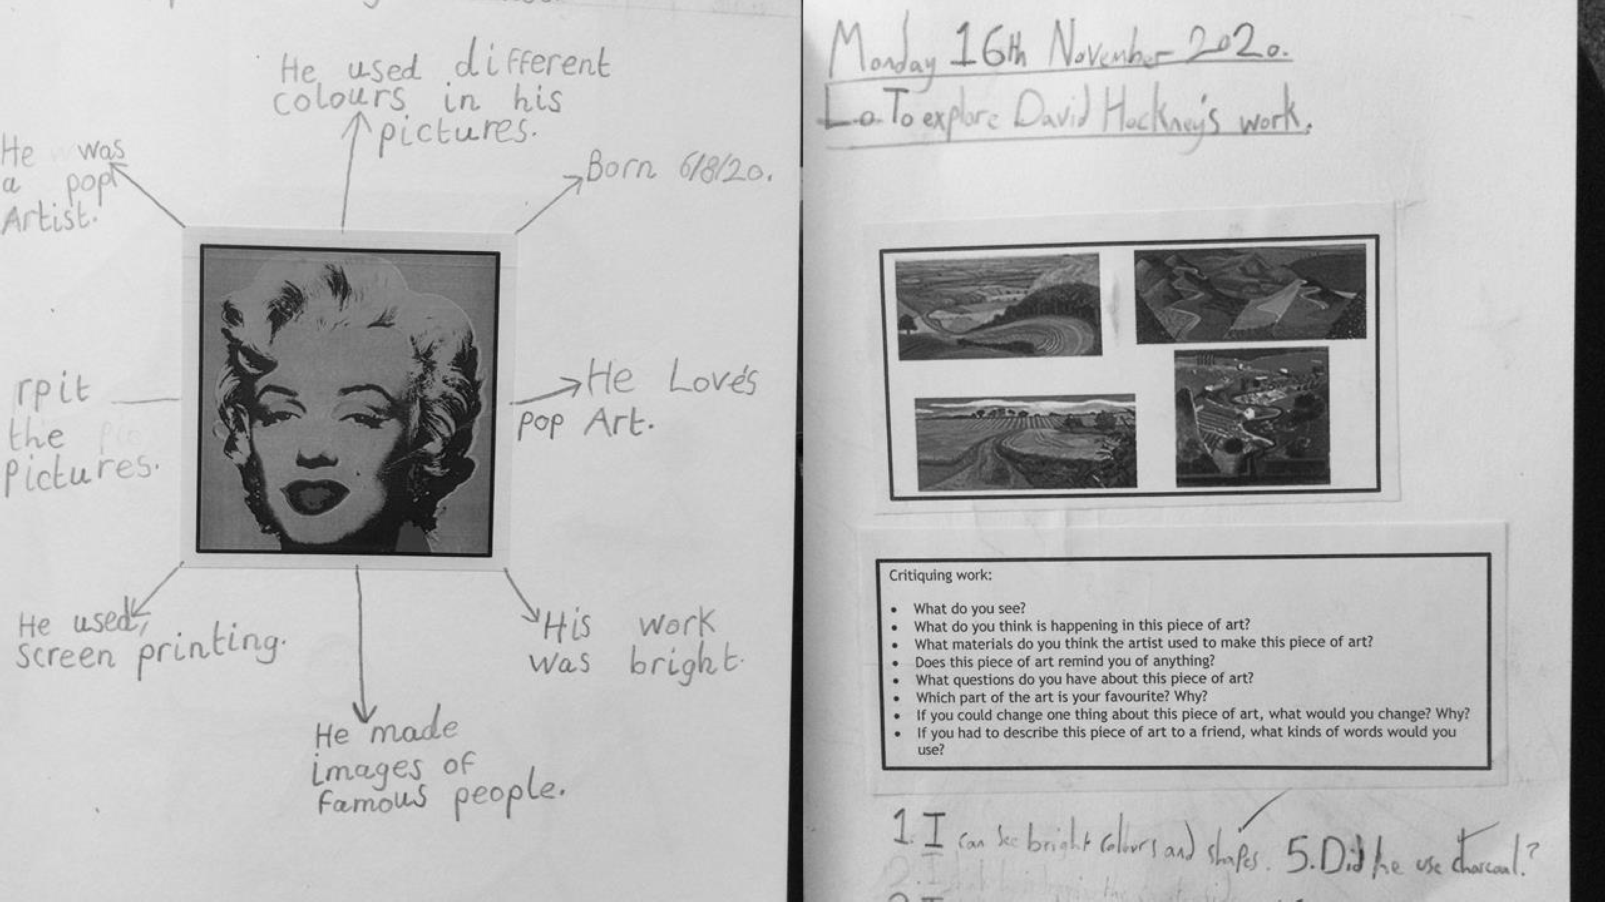

Slide 6
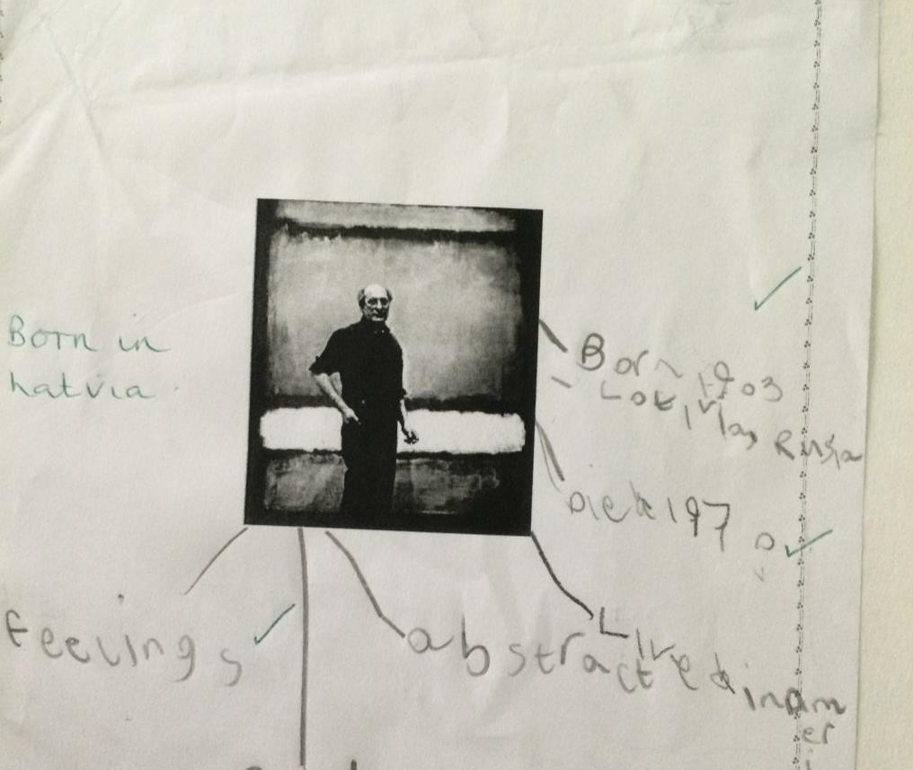
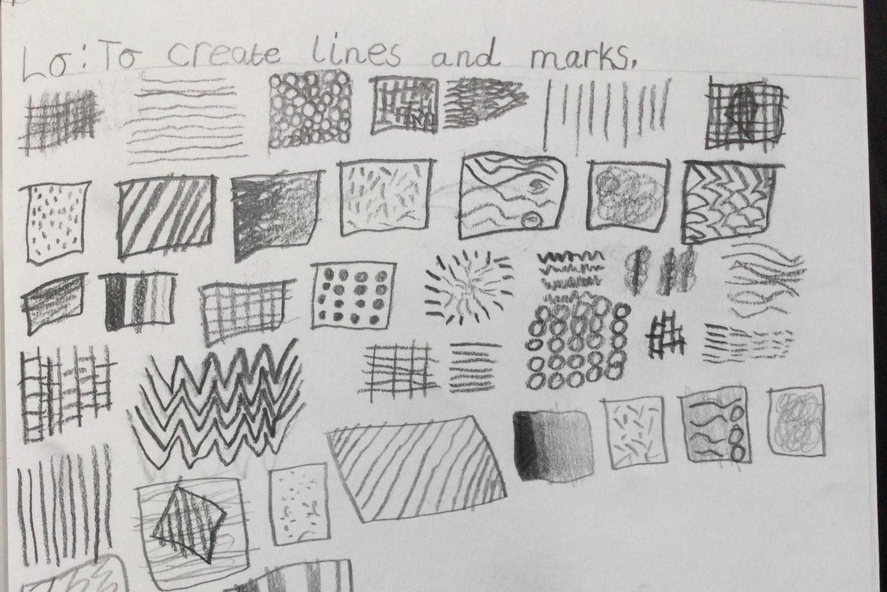

Slide 7
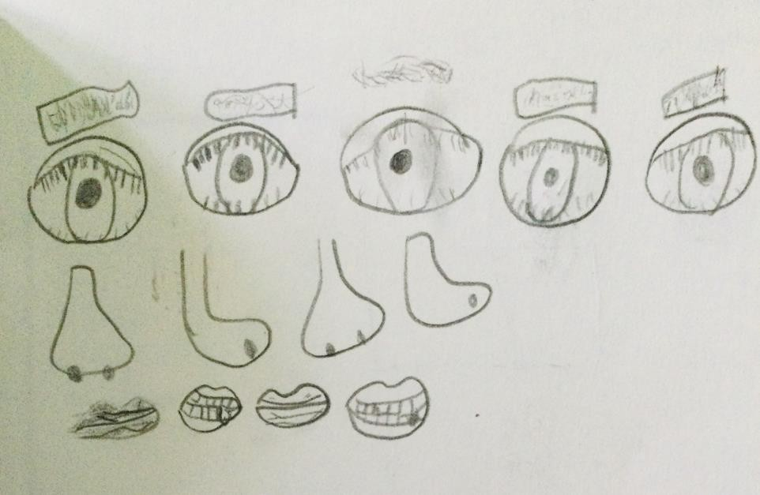
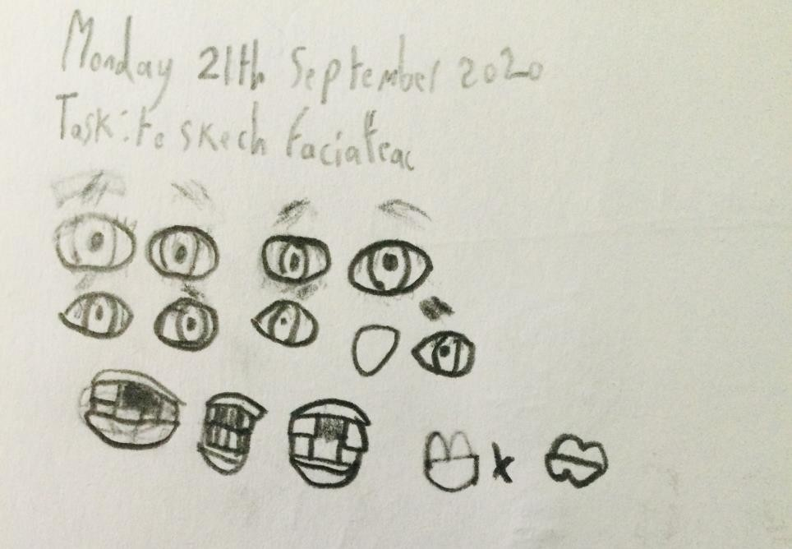

Slide 8

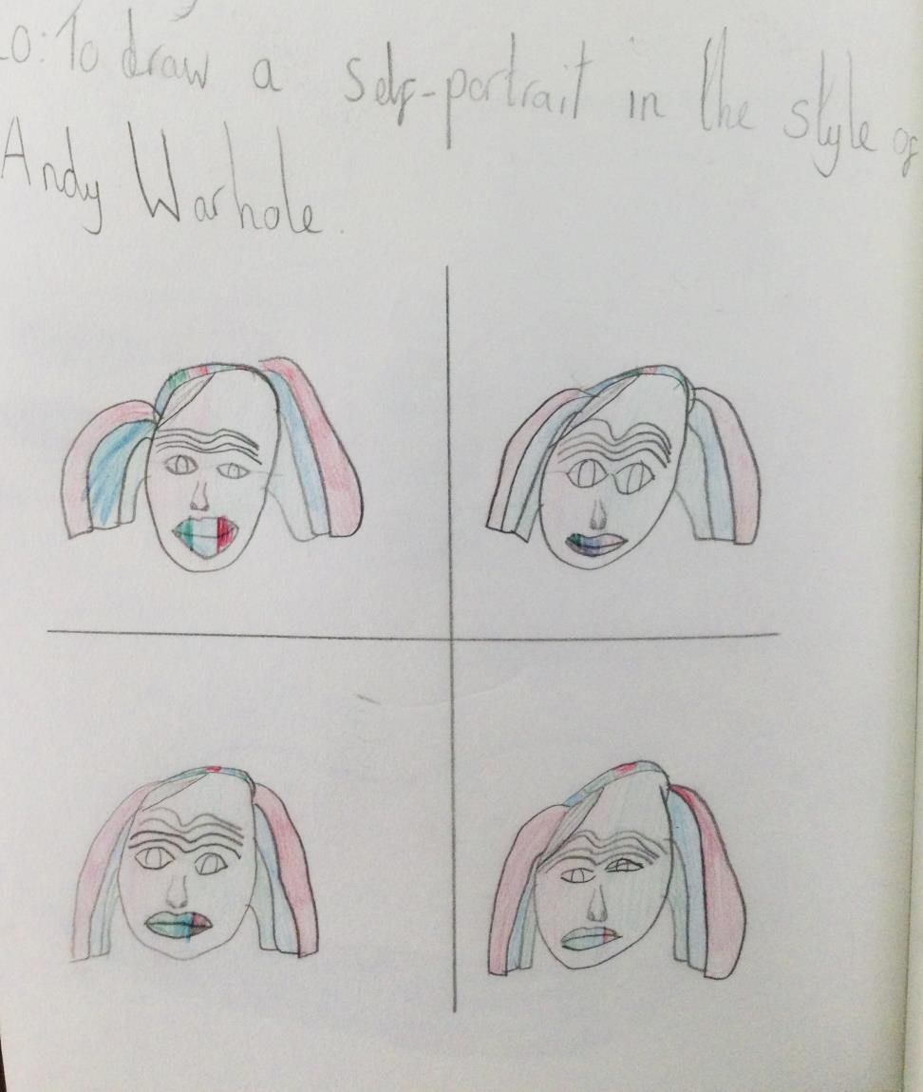
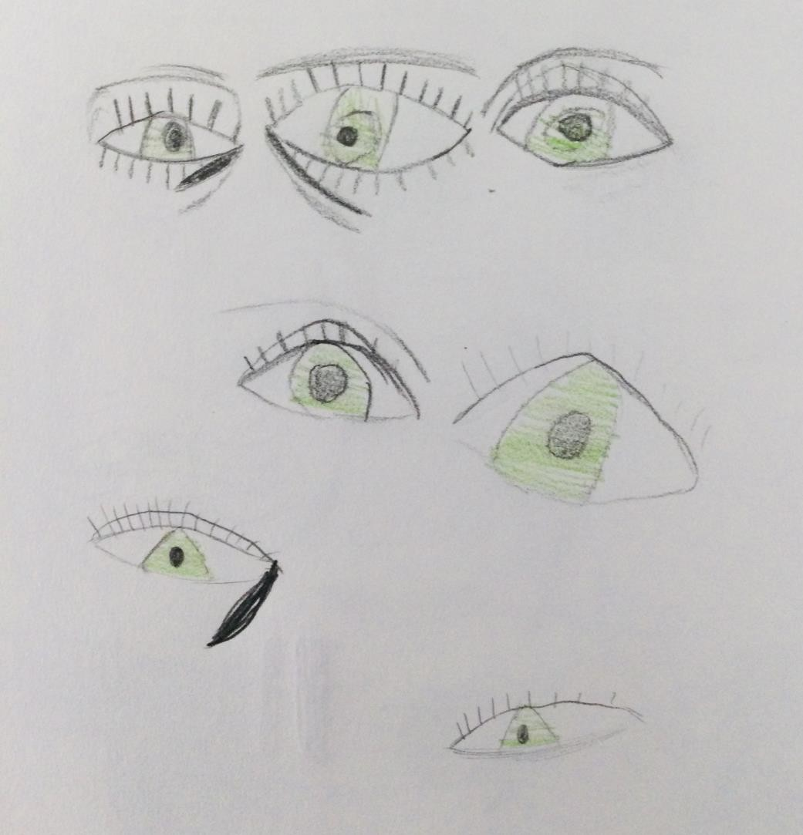

Slide 9
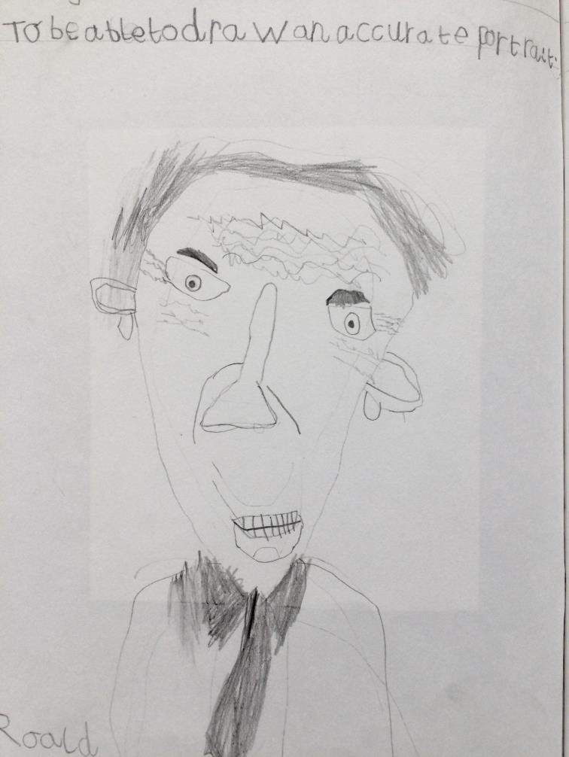

Slide 10
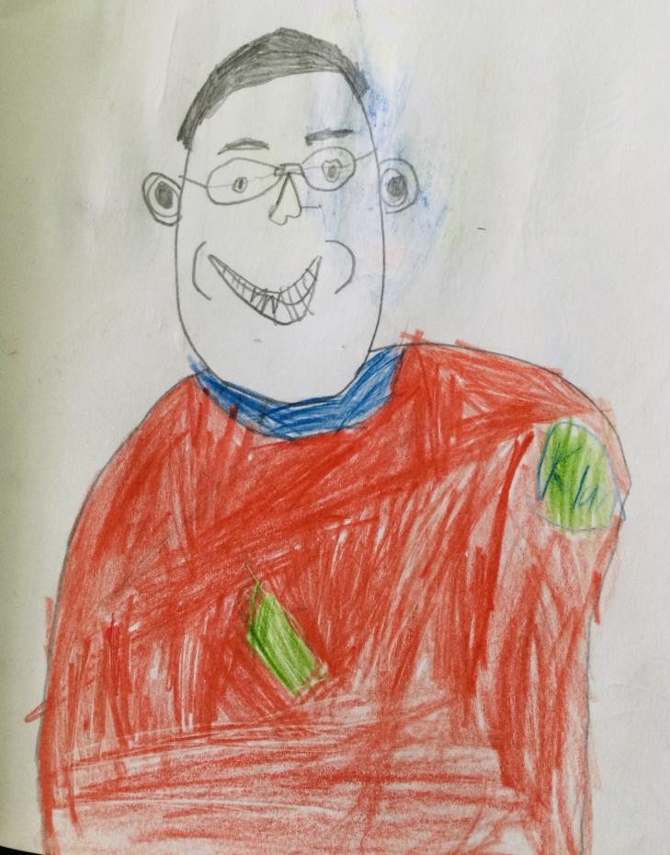

Slide 11
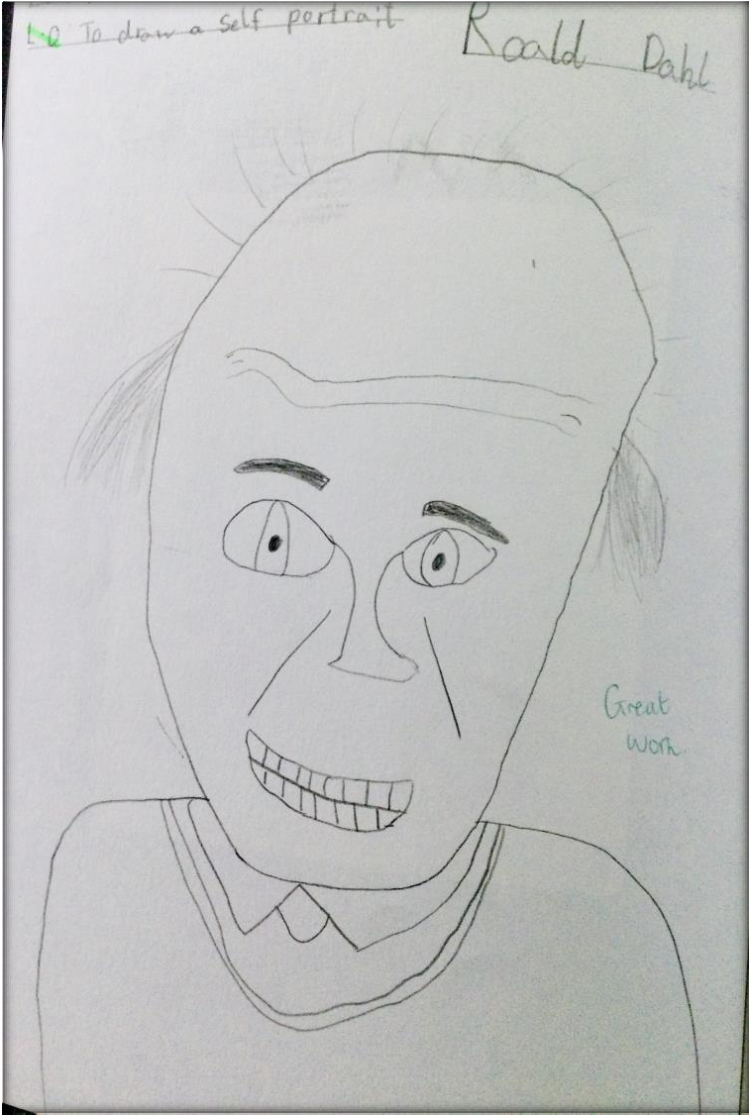

Slide 12
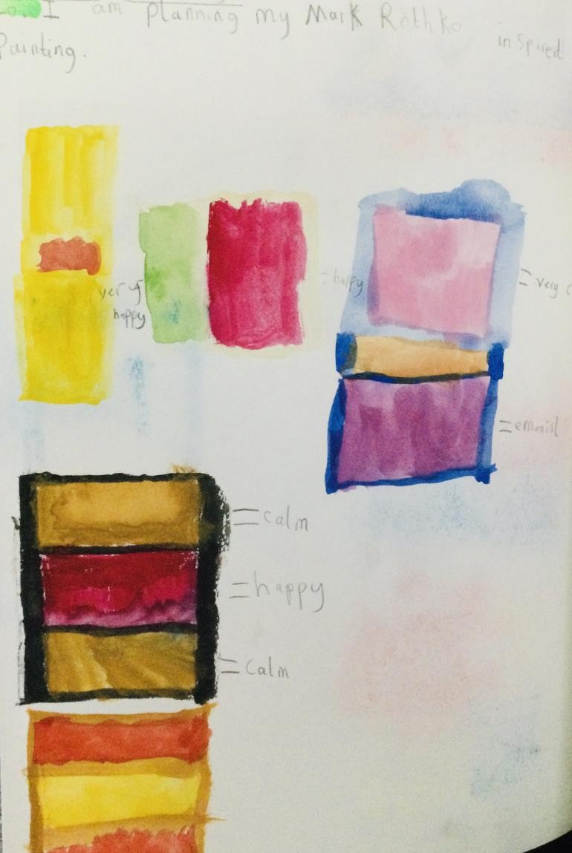

Slide 13
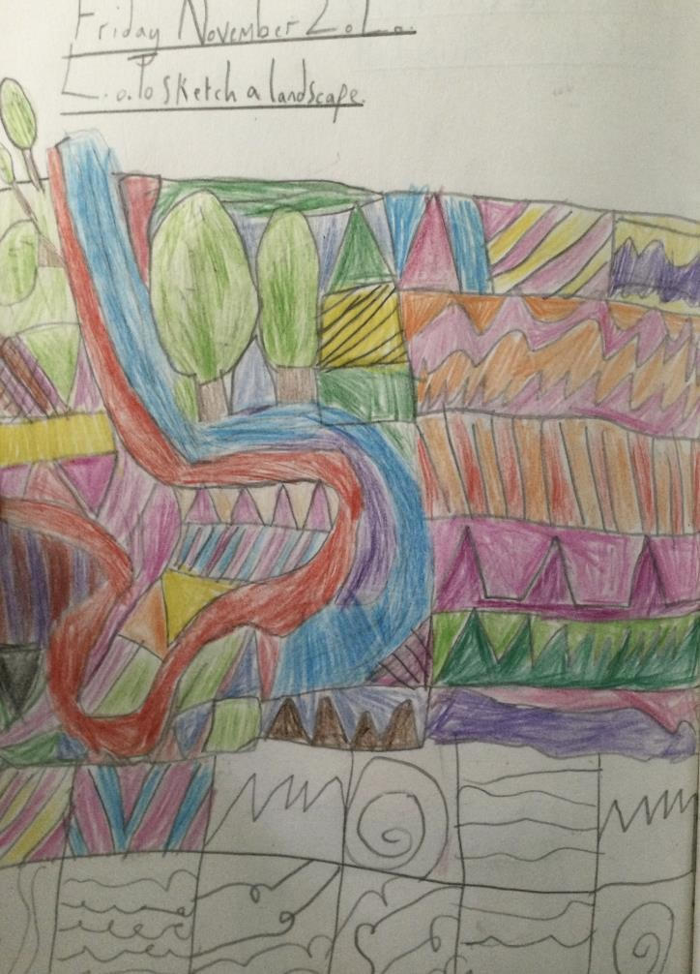
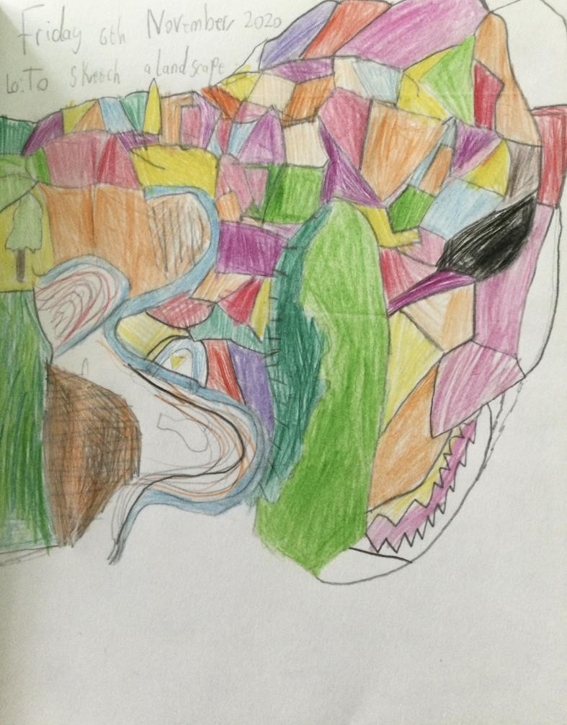

Slide 14
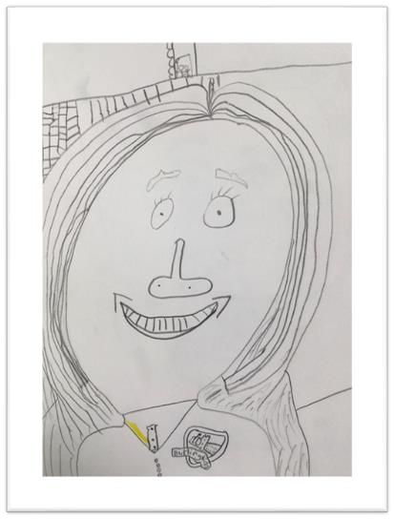
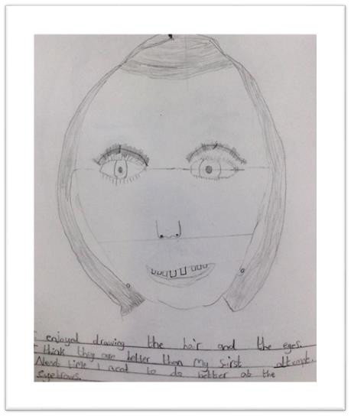
Year 4 – Progression examples.

Slide 15
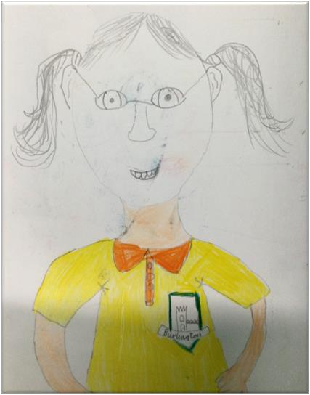
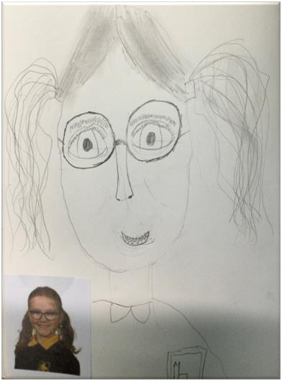

Slide 16


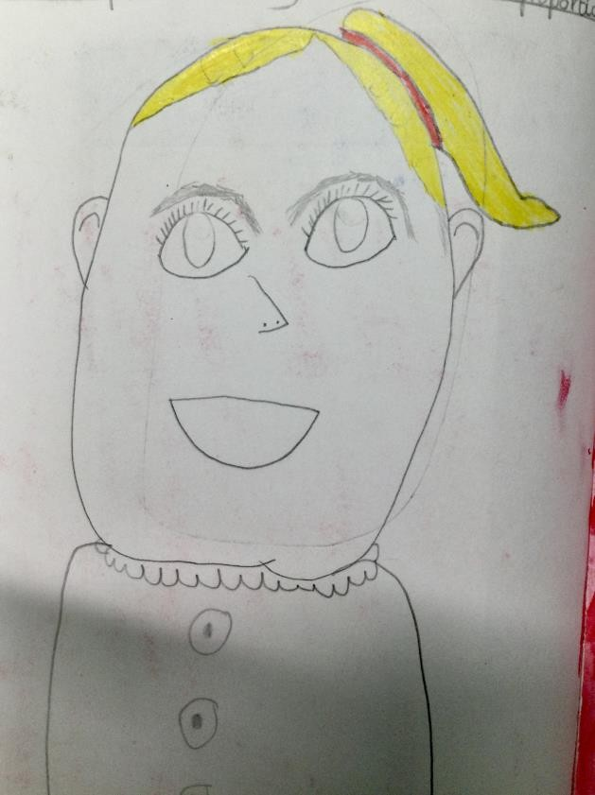
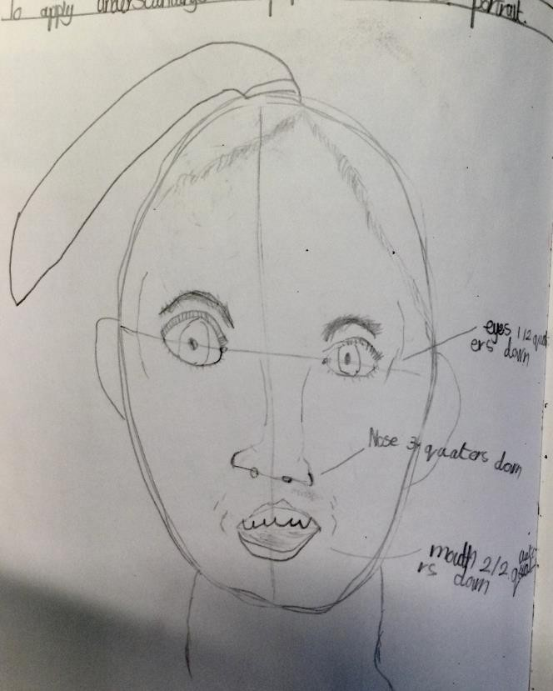
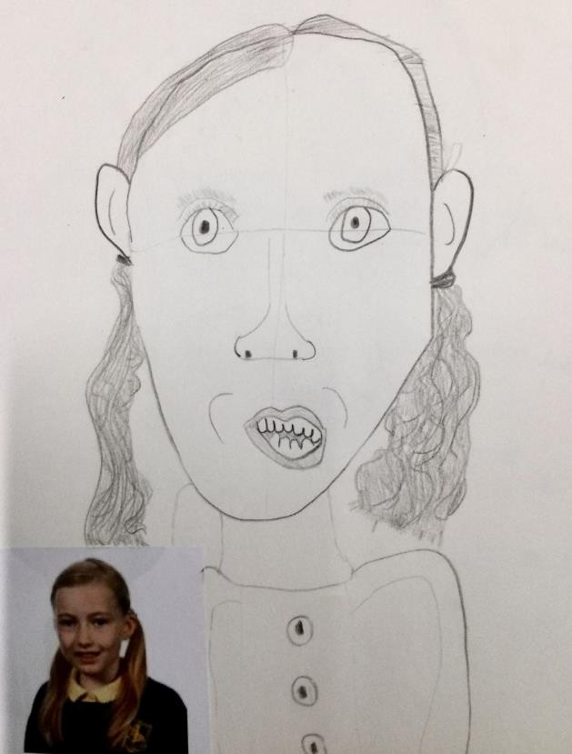
Progress….

Slide 17
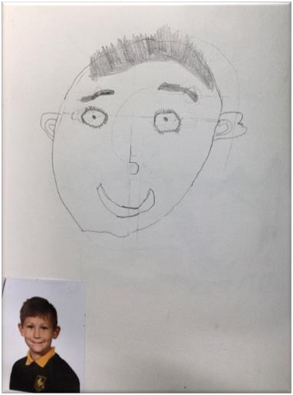
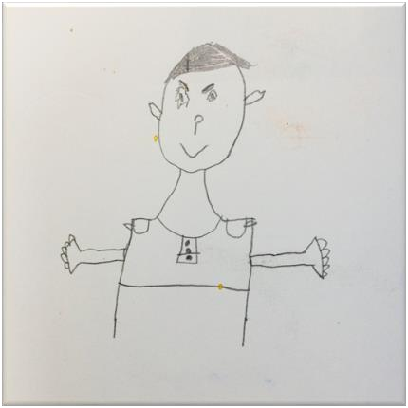

Slide 18
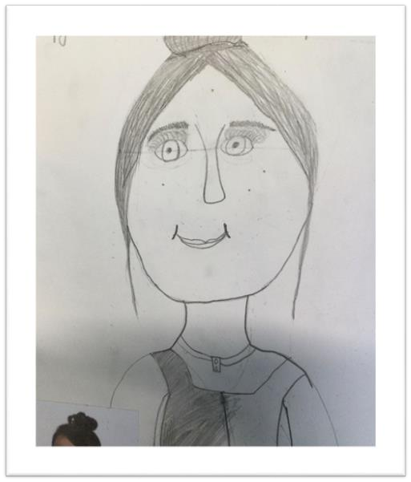
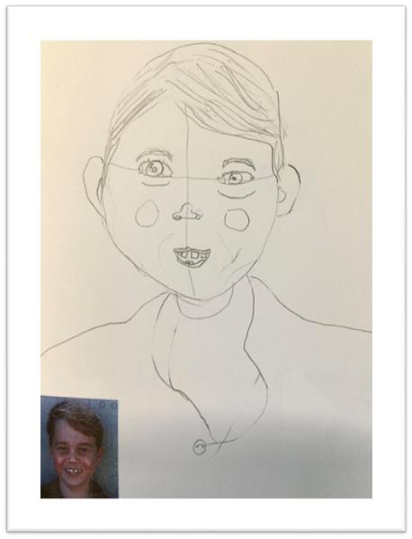

Slide 19
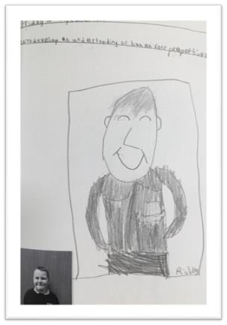
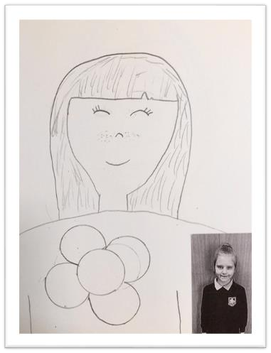
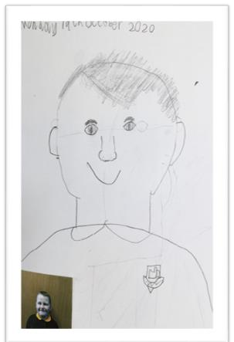
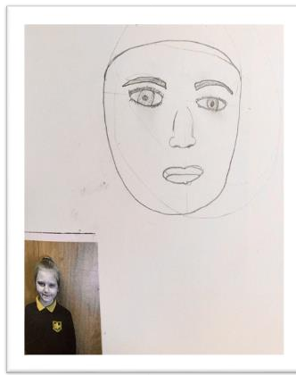

Slide 20
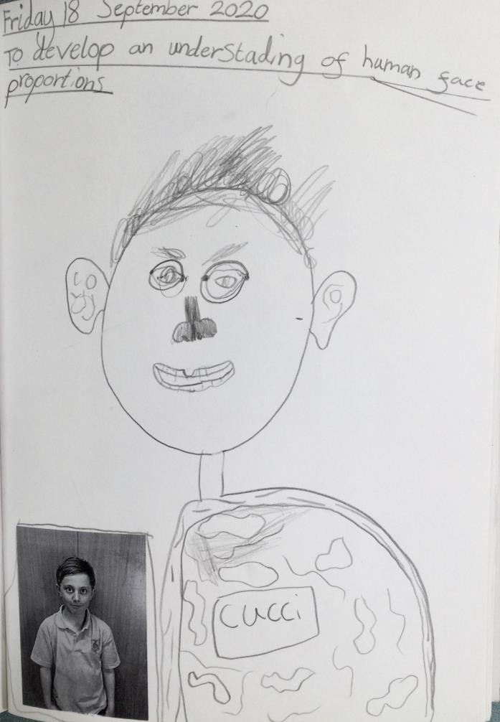
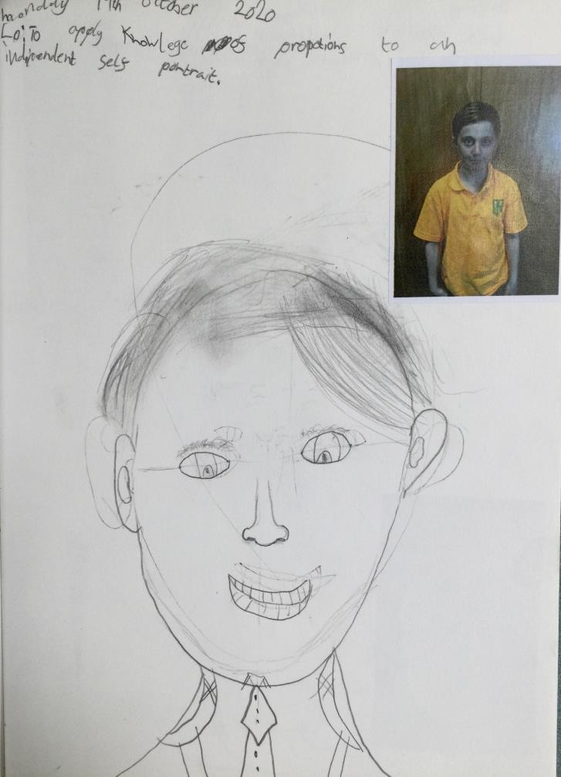

Slide 21
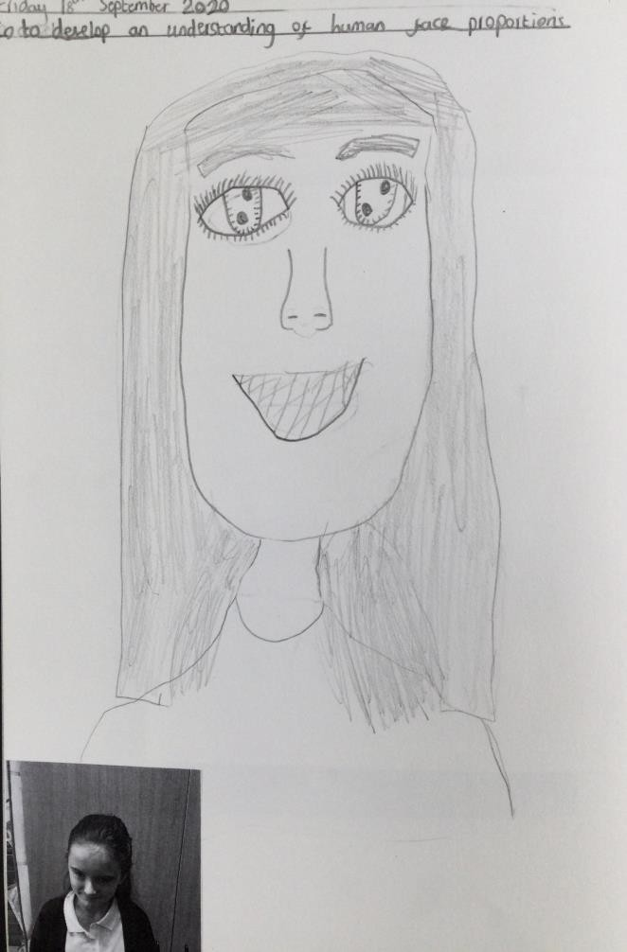
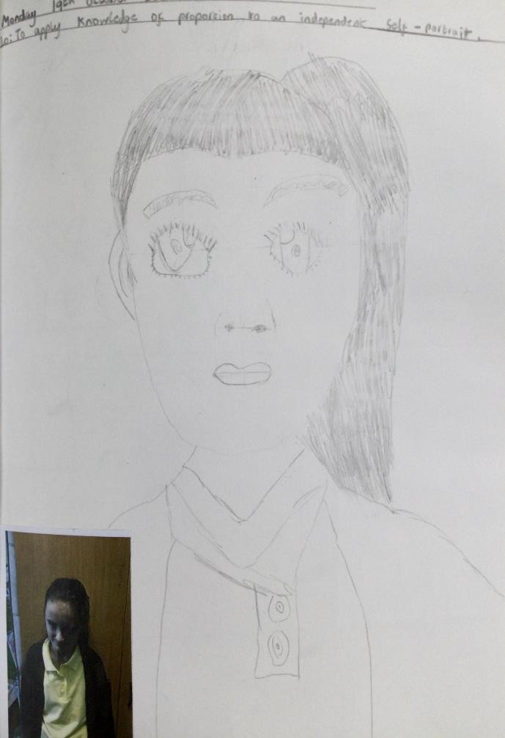

Slide 22
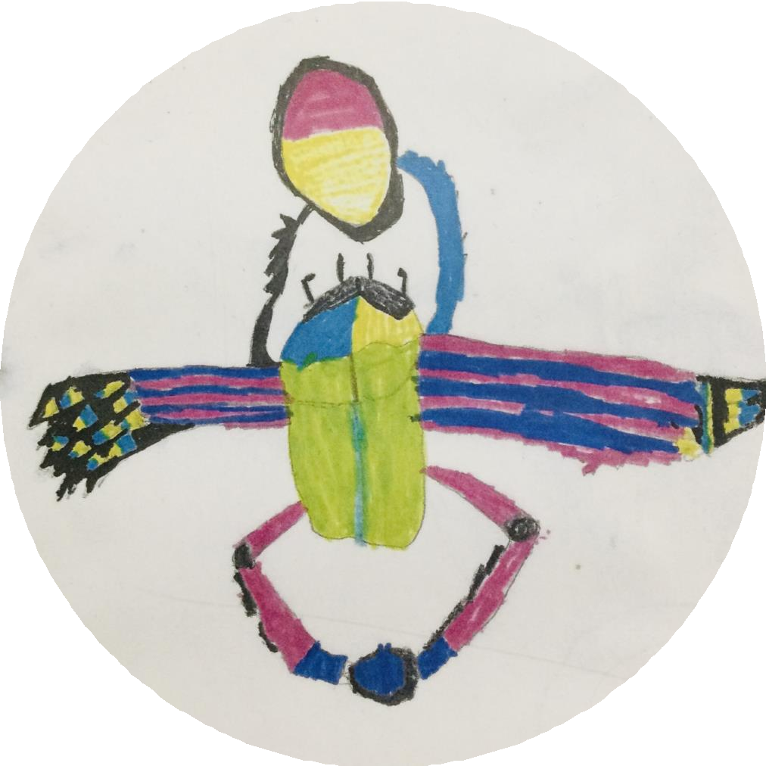
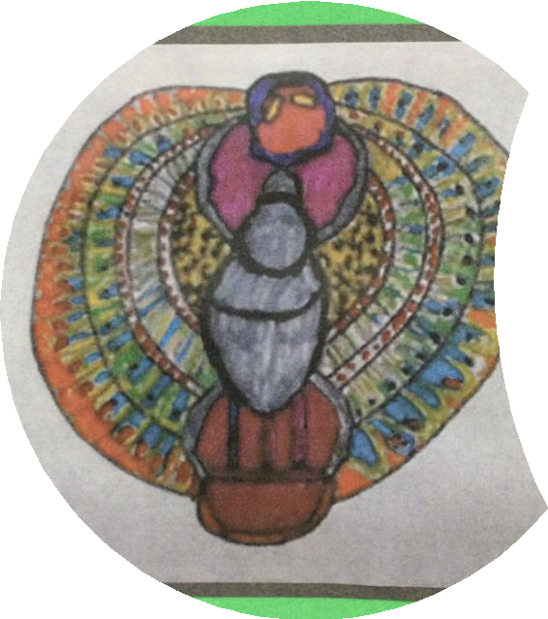
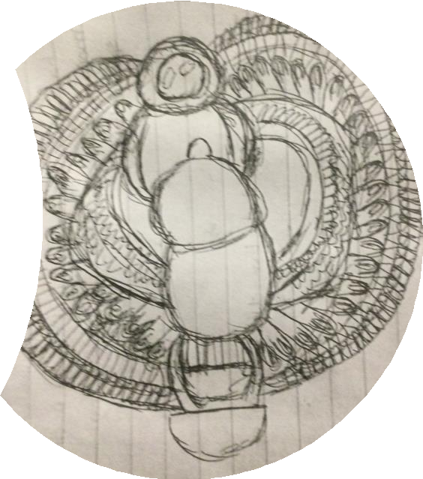

Slide 23
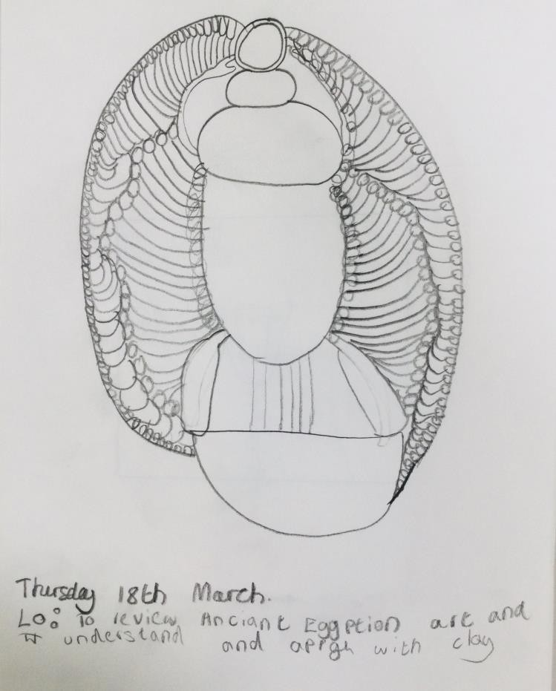
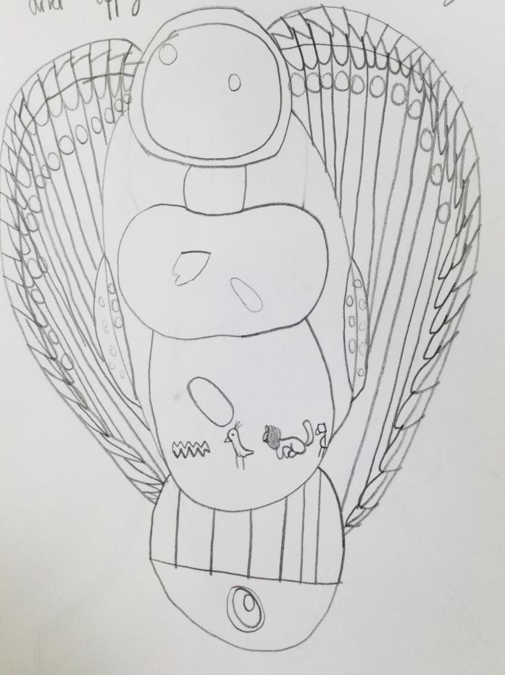

Slide 24
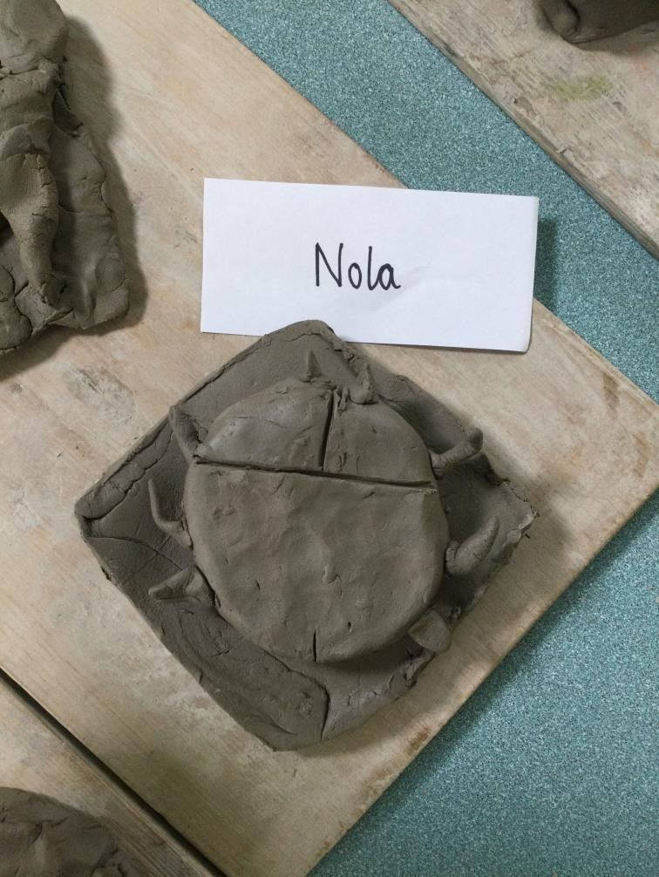
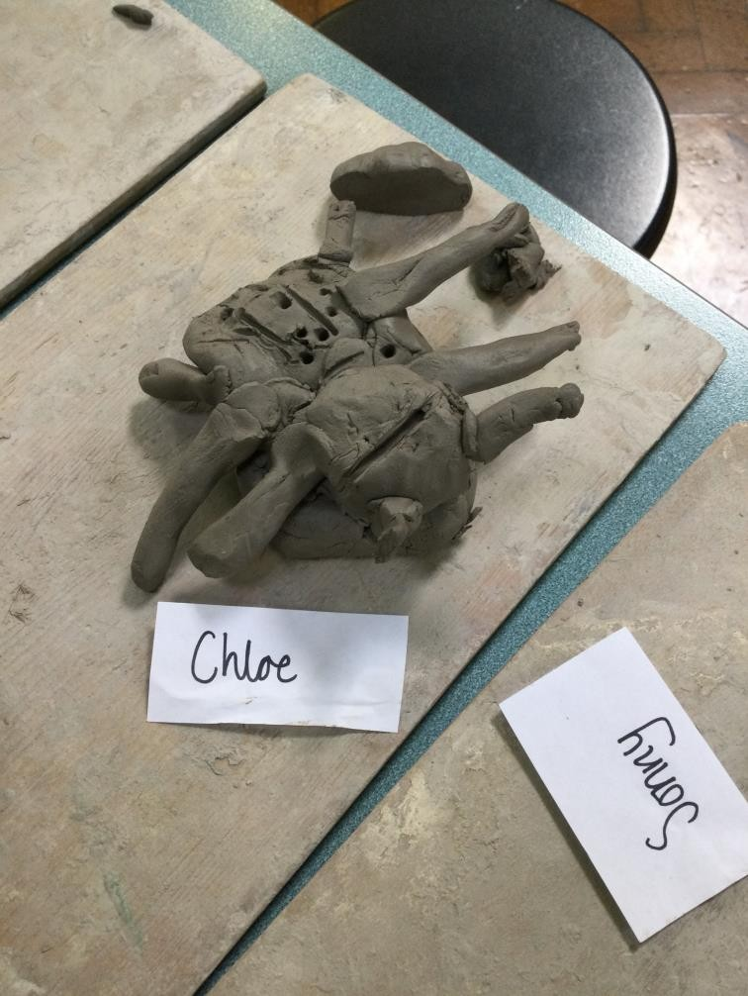

Slide 25




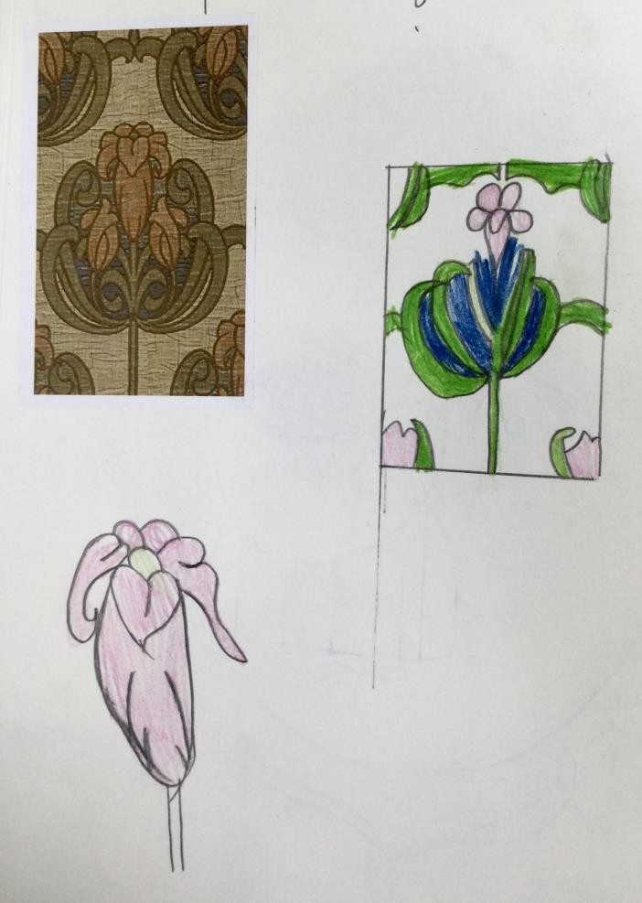
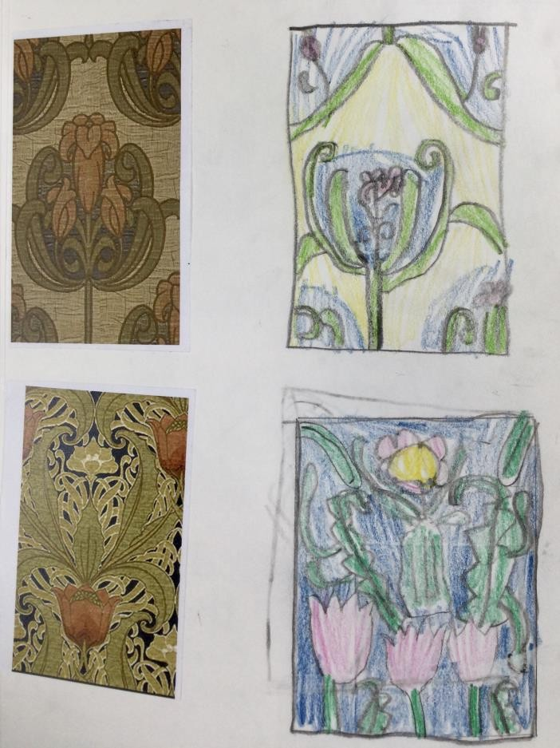
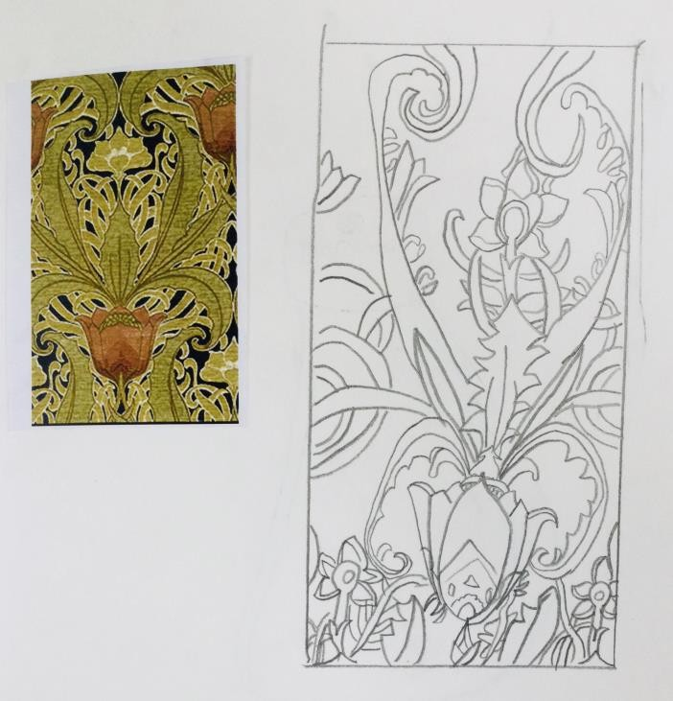

Slide 26
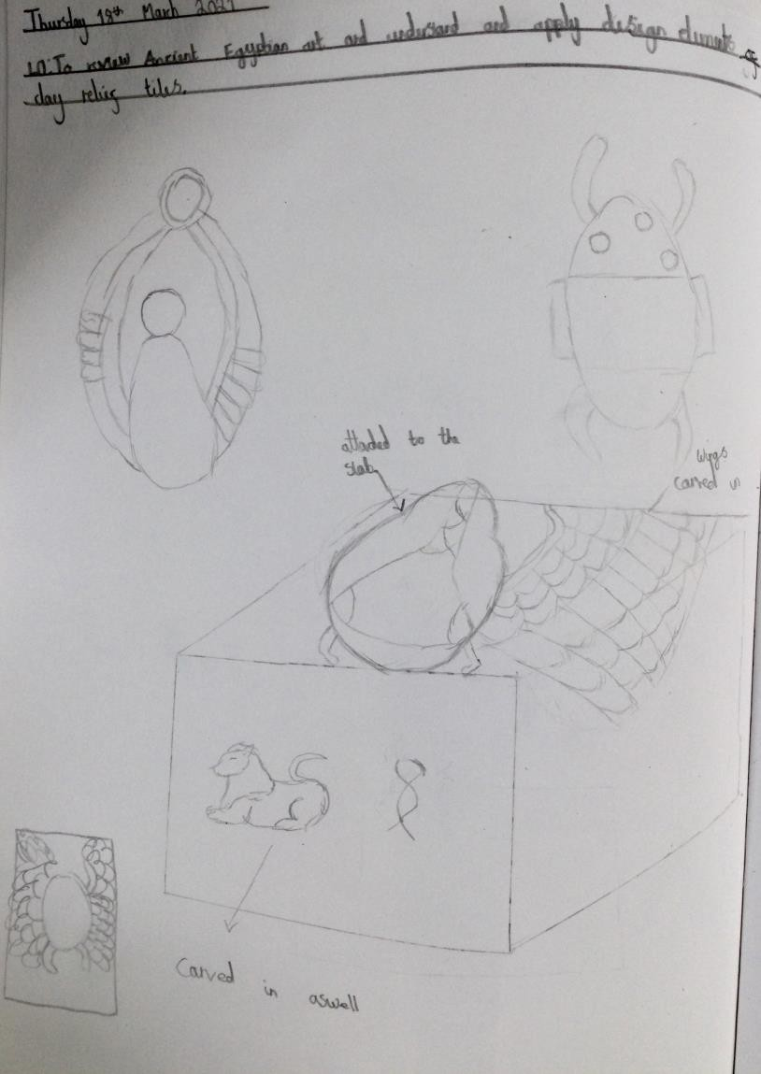
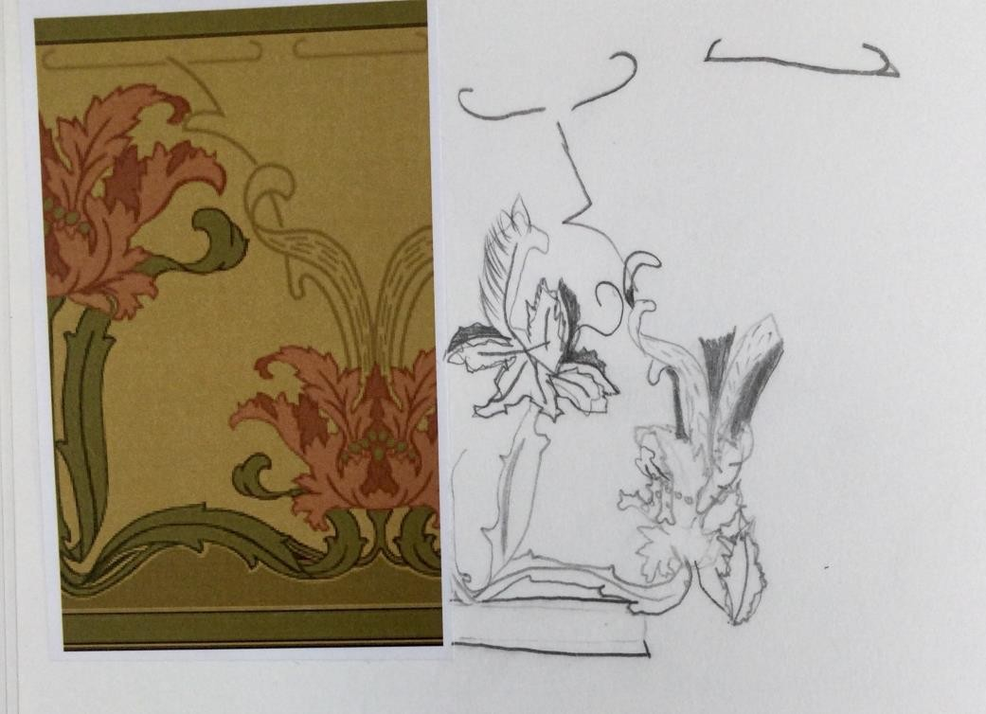

Slide 27
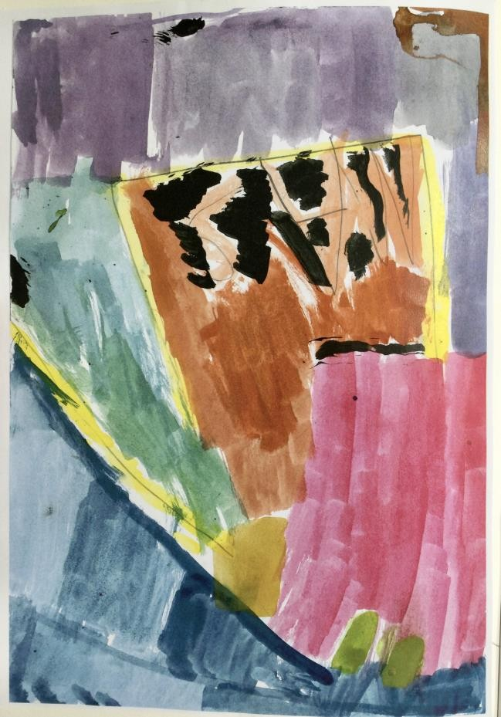

Slide 28



Slide 29


Slide 30



Year 5

Slide 31





Slide 32



Slide 33



Slide 34





Progress over five lessons.

Slide 35

THE SAME BOY THAT CREATED THE PREVIOUS PORTRAITS (THE BOY WHO CRIED BECAUSE HE HATED ART AND SAID HE COULDN’T DRAW), THEN DREW THIS AT THE END OF THE YEAR! WOW!

Slide 36




Developing and refining drawing skills.

Slide 37



Slide 38



Slide 39




Slide 40


Slide 41



Slide 42


Slide 43



Slide 44




Slide 45



Slide 46


Slide 47


Slide 48




Slide 49




Slide 50



Slide 51



Slide 52



Slide 53



Slide 54


Slide 55




Slide 56




Slide 57




Slide 58




Slide 59



Slide 60






Slide 61




Slide 62



Slide 63


Slide 64




Slide 65



Slide 66


Slide 67


Slide 68


Slide 69


Slide 70



Slide 71


Slide 72


Slide 73


Slide 74



Slide 75



Slide 76



Slide 77



Slide 78



Year 6

Slide 79



Slide 80



Slide 81




Slide 82



Progress…

Slide 83




Slide 84



Slide 85




Slide 86



Slide 87


Year 5 to Year 6

Slide 88




Slide 89




Slide 90


Year 5 to Year 6

Slide 91


Year 5 to Year 6

Slide 92



Slide 93


